Slide 1



Sakura Medal Books 2025
English High School Books

Slide 2

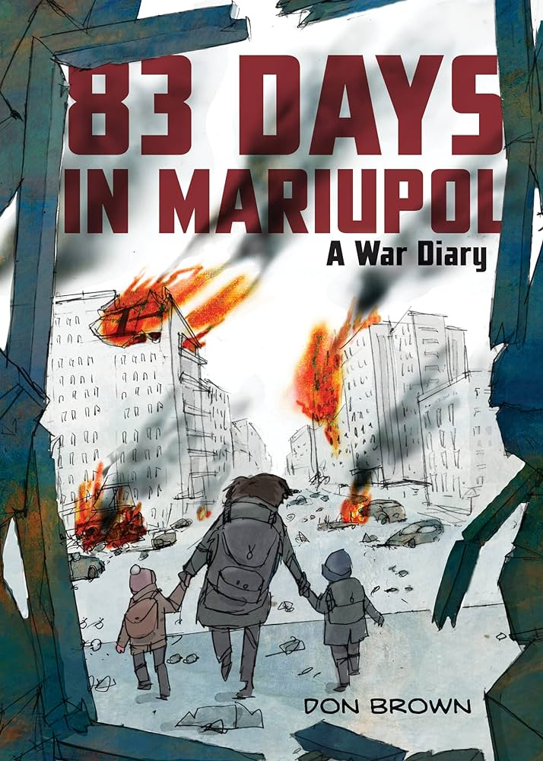

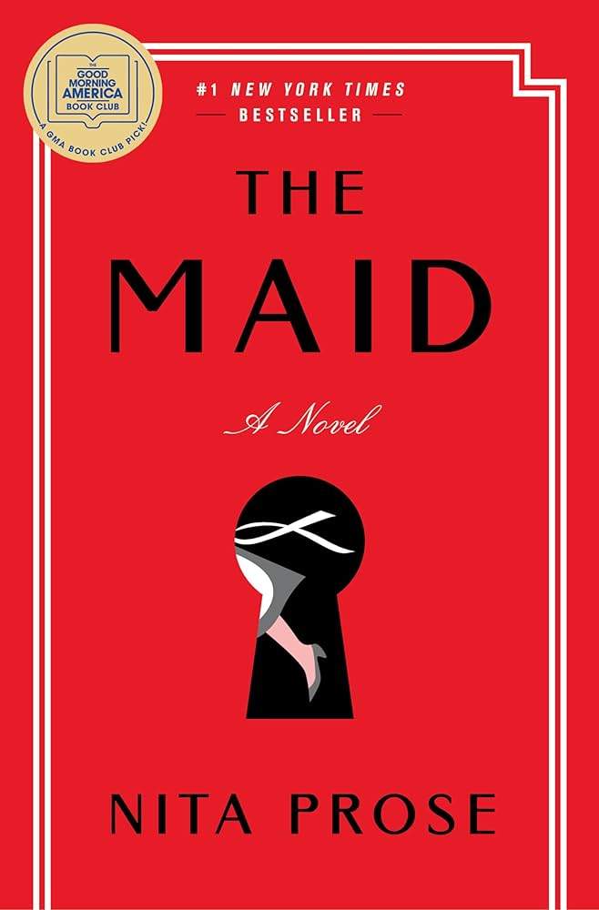
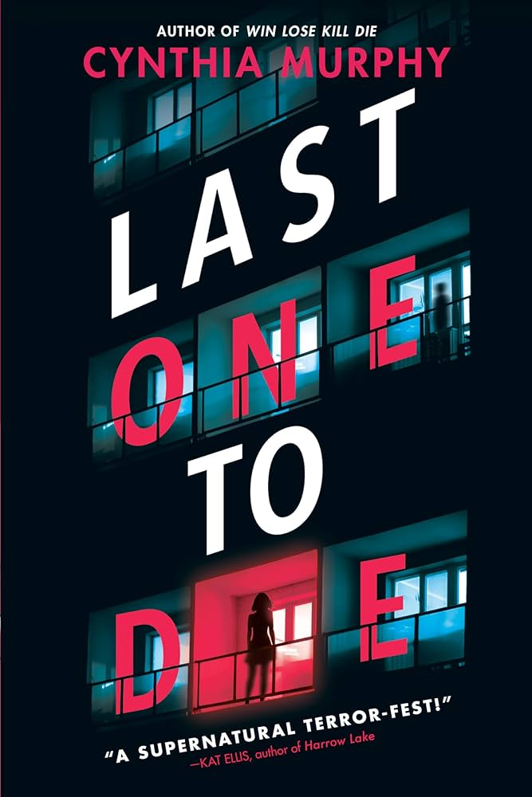

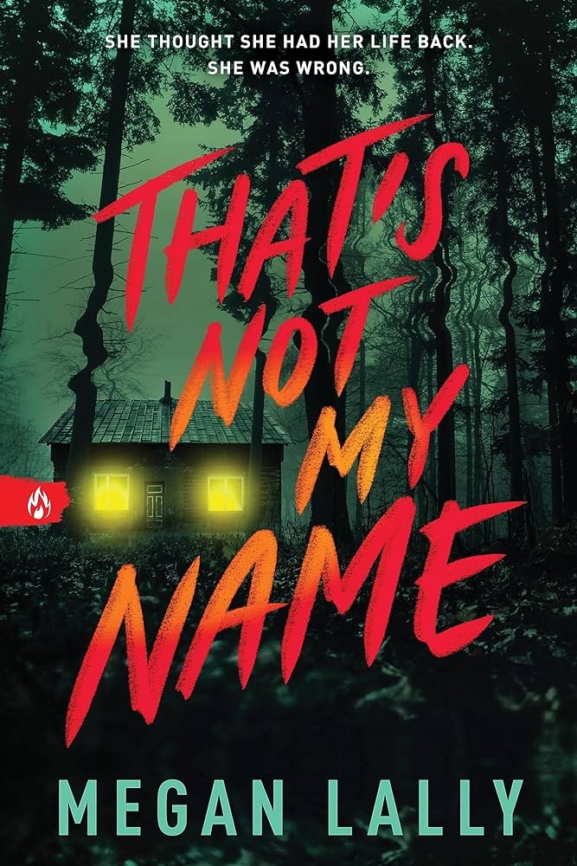

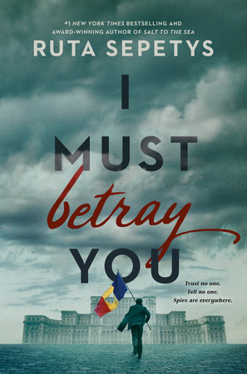
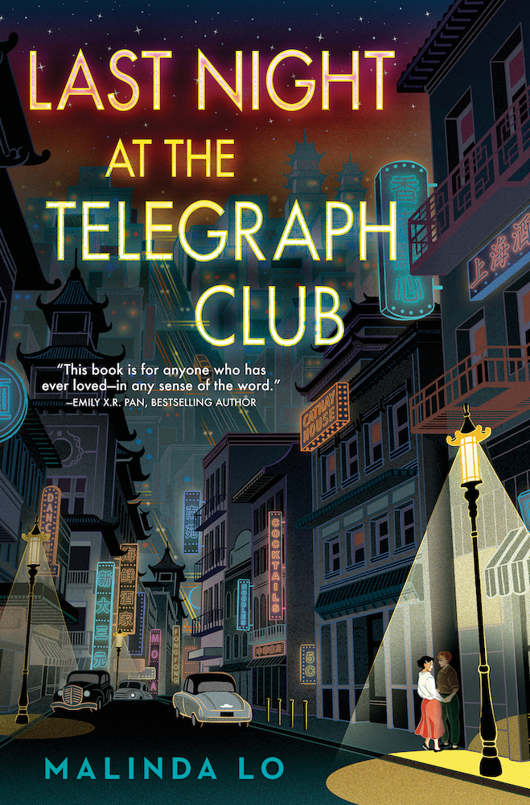

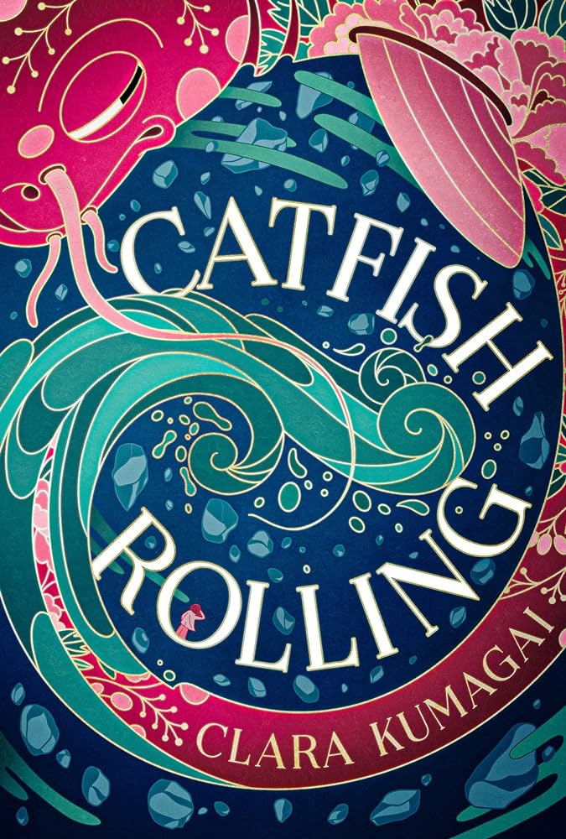
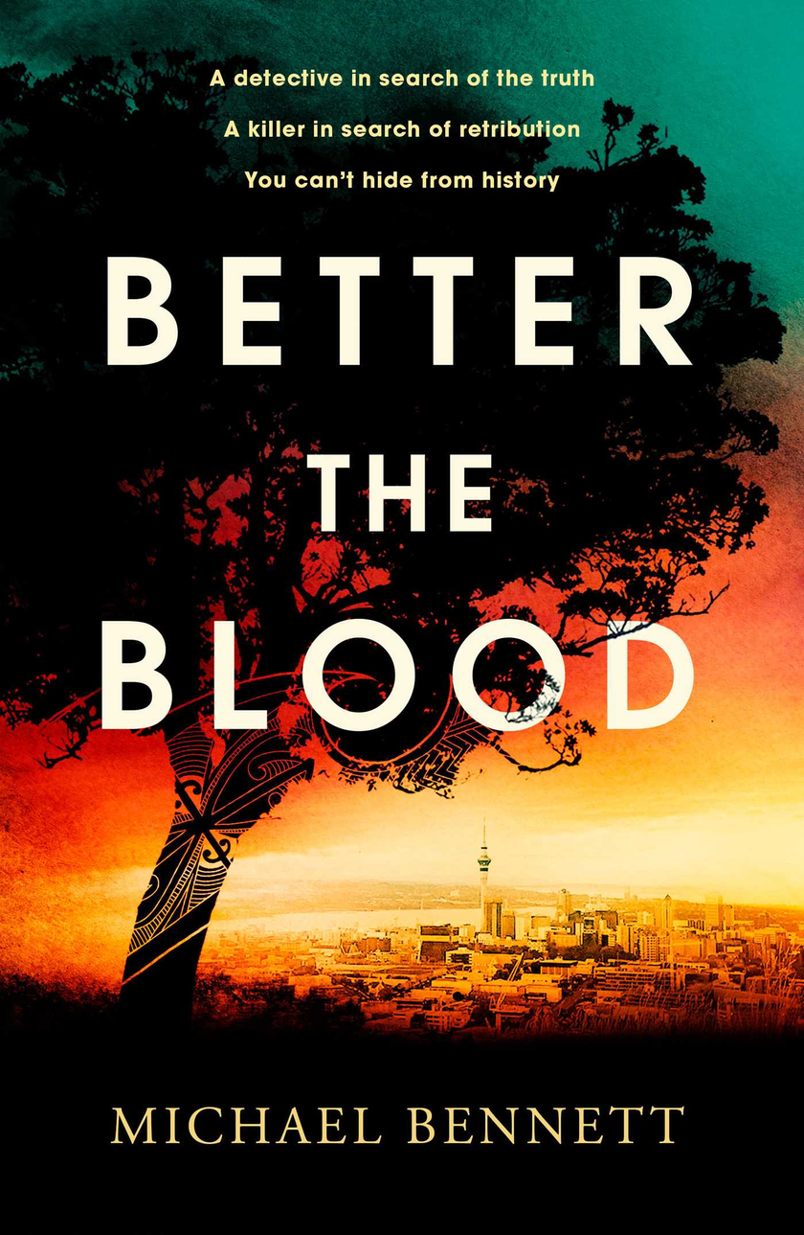
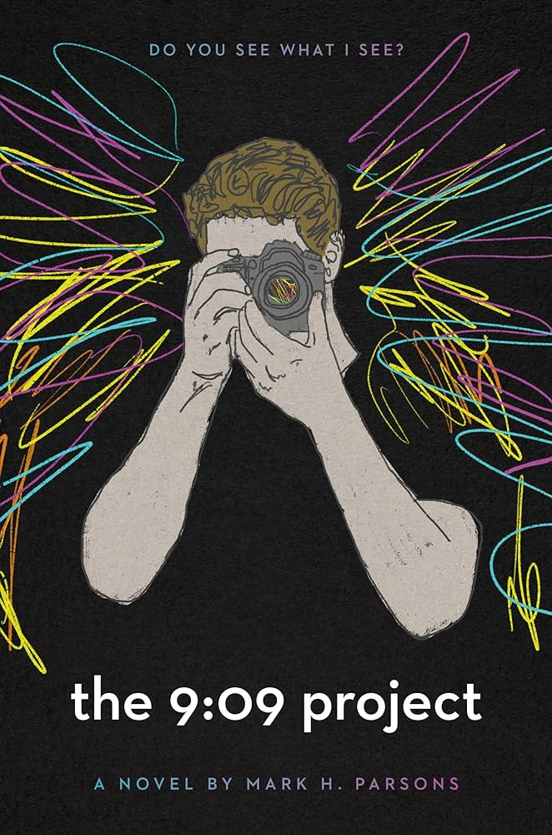




Slide 3



83 Days in Mariupol: A War Diary by Don Brown
Don Brown
A young adult graphic novel that captures the complexities of the war in Ukraine, focusing on the siege of Mariupol (Feb ’22 – May ’22) and the brave people who stayed to defend their city against Russian forces as well as the resulting effects on global politics. A city ruined. In once quiet residential streets, two armies battle, driving people into cellars and basements with little food or water. No lights or heat. Dwindling medical supplies. Shells and bullets deliver cruel, random death to the young and old, men, women, and children. This is Mariupol, a Ukrainian city and early target of Russia’s invasion of Ukraine. Bordering Russian-occupied territory, the coastal city seemed doomed to a defeat that would come within days, if not hours. Could Mariupol, and Ukraine, survive? As Russian rockets threatened the city, Ukrainians resisted, and with a heroic combination of sacrifice and bravery, the besieged city endured . . . for months. But it all came at a steep cost. With compassion and his keen journalist’s eye, Sibert Honor creator Don Brown illuminates the horrors of Mariupol and the depredations of its people not seen in the city since World War II. He also shows that outside of Mariupol, the city’s agonies were mirrored by similar events occurring in towns and cities across Ukraine. 83 Days in Mariupol reminds us that the bloody defiance shown at the Alamo, Dunkirk, Leningrad, and Thermopylae isn’t confined to the past but has a violent, modern presence. It is the story of senseless destruction, patriotism, and grit against long odds—a brutal battle whose consequences still reverberate across Ukraine and continue to reshape the global political landscape. Read more books by Don

Slide 4


The Boy From Clearwater
Yu Pei-Yun & Zhou Jian-Xin
Part Taiwan, 1930s. Tsai Kun-lin, an ordinary boy born in Qingshui, recounts a carefree childhood despite the Japanese growing up happily in the company of nursery rhymes and picture books on Qingshui Street. As war emerges Tsai's memories shift to military parades, air raids, and watching others face conscription into the army. It seems no one can escape. After the war, the book-loving teenager tries hard to learn Mandarin and believes he is finally stepping towards a comfortable future; but little does he know, a dark cloud awaits him ahead.
Part Taiwan, 1950s. In his second year at Taichung First Senior High School, Tsai is arrested simply for joining a book club and subsequently tortured, deprived of civil rights, and sent to Green Island for "reformation." Lasting until his release in September 1960, Tsai, a victim of the White Terror era, spent ten years of his youth in prison on an unjust charge. But he is ready to embrace freedom.
Experience parts one and two of the tour-de-force graphic novel series that took Taiwan by storm – parts three and four coming May 2024.

Slide 5

The Maid
Nita Prose
Molly Gray is not like everyone else. She struggles with social skills and misreads the intentions of others. Her gran used to interpret the world for her, codifying it into simple rules that Molly could live by.
Since Gran died a few months ago, twenty-five-year-old Molly has been navigating life's complexities alone. No matter—she throws herself with gusto into her work as a hotel maid. Her unique character, along with her obsessive love of cleaning and proper etiquette, makes her an ideal fit for the job. She delights in donning her crisp uniform each morning, stocking her cart with miniature soaps and bottles, and returning guest rooms at the Regency Grand Hotel to a state of perfection.
But Molly's orderly life is upended the day she enters the suite of the infamous and wealthy Charles Black, only to find it in a state of disarray and Mr. Black himself dead in his bed. Before she knows what's happening, Molly's unusual demeanour has the police targeting her as their lead suspect. She quickly finds herself caught in a web of deception, one she has no idea how to untangle. Fortunately for Molly, friends she never knew she had united with her in a search for clues to what happened to Mr Black—but will they be able to find the real killer before it's too late?
A Clue-like, locked-room mystery and a heartwarming journey of the spirit, The Maid explores what it means to be the same as everyone else and yet entirely different—and reveals that all mysteries can be solved through connection to the human heart.

Slide 6
Last One To Die
Cynthia Murphy
A supernatural thriller that will keep you guessing until the very end. Packed with voice-driven whodunit storytelling, and a classic slasher-movie feel, this dark, pacy, and irresistibly creepy thriller really has something for everybody!
16-year-old, Irish-born Niamh has just arrived in London for the summer and quickly discovers that girls who look frighteningly like her are being attacked.
Determined to make it through her Drama Course, Niamh is placed at the Victorian Museum to put her drama skills to the test, and there she meets he’s kind, fun, attentive, and really hot! Nonetheless, there's something eerie about the museum...
As present-day serial attackers and sinister Victorian history start to collide, Niamh realizes that things are not as they seem. Will she be next?

Slide 7

YellowFace
R. F. Kuang
Authors June Hayward and Athena Liu were supposed to be twin rising stars. But Athena’s a literary darling. June Hayward is nobody. Who wants stories about basic white girls, June thinks.
So when June witnesses Athena’s death in a freak accident, she acts on impulse: she steals Athena’s just-finished masterpiece, an experimental novel about the unsung contributions of Chinese labourers during World War I.
So what if June edits Athena’s novel and sends it to her agent as her work? So what if she lets her new publisher rebrand her as Juniper Song—complete with an ambiguously ethnic author photo? Doesn’t this piece of history deserve to be told, whoever the teller is? That’s what June claims, and the New York Times bestseller list seems to agree.
But June can’t get away from Athena’s shadow, and emerging evidence threatens to bring June’s (stolen) success down around her. As June races to protect her secret, she discovers exactly how far she will go to keep what she thinks she deserves.

Slide 8


That’s Not My Name
Megan Lally
She thought she had her life back. She was wrong. It was a mistake to trust him.
Shivering and bruised, a teen wakes up on the side of a dirt road with no memory of how she got there―or who she is. A passing officer takes her to the police station, and not long after, a frantic man arrives. He's been searching for her for hours. He has her school ID, her birth certificate, and even family photos. He is her father. Her name is Mary. Or so he says.
When Lola slammed the car door and stormed off into the night, Drew thought they just needed some time to cool off. Except Lola disappeared, and the sheriff, his friends, and the whole town are convinced Drew murdered his girlfriend. Forget proving his innocence, he needs to find her before it's too late. The longer Lola is missing, the fewer leads there are to follow…and the more danger they both are in.

Slide 9


I Must Betray You
Ruta Sepetys
Romania, 1989. Communist regimes are crumbling across Europe. Seventeen-year-old Cristian Florescu dreams of becoming a writer, but Romanians aren’t free to dream; they are bound by rules and force.
Amidst the tyrannical dictatorship of Nicolae Ceaușescu in a country governed by isolation and fear, Cristian is blackmailed by the secret police to become an informer. He’s left with only two choices: betray everyone and everything he loves—or use his position to creatively undermine the most notoriously evil dictator in Eastern Europe.
Cristian risks everything to unmask the truth behind the regime, give voice to fellow Romanians, and expose to the world what is happening in his country. He eagerly joins the revolution to fight for change when the time arrives. But what is the cost of freedom?

Slide 10





Last Night at the Telegraph Club
Malinda Lo
“That book. It was about two women, and they fell in love with each other.” And then Lily asked the question that had taken root in her, that was even now unfurling its leaves and demanding to be shown the sun: “Have you ever heard of such a thing?”
Seventeen-year-old Lily Hu can’t remember exactly when the question took root, but the answer was in full bloom the moment she and Kathleen Miller walked under the flashing neon sign of a lesbian bar called the Telegraph Club.
America in 1954 is not a safe place for two girls to fall in love, especially not in Chinatown. Red-Scare paranoia threatens everyone, including Chinese Americans like Lily. With deportation looming over her father—despite his hard-won citizenship—Lily and Kath risk everything to let their love see the light of day.

Slide 11


The Deep Sky
Yume Kitasei
They left Earth to save humanity. They’ll have to save themselves first.
It is the eve of Earth’s environmental collapse. A single ship carries humanity’s last hope: eighty elite graduates of a competitive program, who will give birth to a generation of children in deep space. But halfway to a distant but livable planet, a lethal bomb kills three of the crew and knocks The Phoenix off course. Asuka, the only surviving witness, is an immediate suspect.
Asuka already felt like an impostor before the explosion. She was the last picked for the mission, she struggled during training back on Earth, and she was chosen to represent Japan, a country she only partly knows as a half-Japanese girl raised in America. But estranged from her mother back home, The Phoenix is all she has left.
With the crew turning on each other, Asuka is determined to find the culprit before they all lose faith in the mission—or worse, the bomber strikes again.

Slide 12
Catfish Rolling
Clara Kumagai
Magic-realism blends with Japanese myth and legend in an original story about grief, memory, time and an earthquake that shook a nation.
There's a catfish under the islands of Japan and when it rolls the land rises and falls.
Sora hates the catfish whose rolling caused an earthquake so powerful it cracked time itself. It destroyed her home and took her mother. Now Sora and her scientist father live close to the zones – the wild and abandoned places where time runs faster or slower than normal. Sora is sensitive to the shifts, and her father recruits her help in exploring these liminal spaces.
But it's dangerous there – and as she strays further inside in search of her mother, she finds that time distorts, memories fracture and shadows, a glimmer of things not entirely human, linger. After Sora's father goes missing, she has no choice but to venture into uncharted spaces within the time zones to find him, her mother and perhaps even the catfish itself...

Slide 13

Better the Blood
Michael Bennett
A DETECTIVE IN SEARCH OF THE TRUTH
Hana Westerman is a tenacious Māori detective juggling single motherhood and the pressures of her career in Auckland’s Central Investigation Branch. When she’s led to a crime scene by a mysterious video, she discovers a man hanging in a secret room. As Hana and her team work to track down the killer, other deaths lead her to think that they are searching for New Zealand’s first serial killer.
A KILLER IN SEARCH OF RETRIBUTION
With little to go on, Hana must use all her experience as a police officer to try and find a motive for these unrelated murders. What she eventually discovers is a link to a historic crime that leads back to the brutal bloody colonisation of New Zealand.
A CLASH BETWEEN CULTURE AND DUTY
When the pursuit becomes frighteningly personal, Hana realises that her heritage and knowledge are their only keys to finding the killer.
THE PAST NEVER TRULY STAYS BURIED
But as the murders continue, it seems that the killer's agenda of revenge may include Hana – and her family . . .
WELCOME TO THE DARK SIDE OF PARADISE.

Slide 14

The 9:09 Project
Mark H. Parsons
It has been two years since his mom’s death, and Jamison, his dad, and his younger sister seem to be coping, but they’ve been dealing with their loss separately and in different ways. When Jamison has to be reminded of his mother’s birthday, on the day of her birthday, he worries that his memory of her is slipping away, and he is forced to reckon with the passing of time. To help make sense of it, he picks up his camera—the Nikon his mother gave him a few years back.
Jamison begins to take photos of ordinary people on the street, at the same time and place each night. As he focuses his lens on the random people who cross his path, Jamison begins to see the world in a deeper way. His endeavor turns into a school project, and then into something more. Along with his new outlook, Jamison forges new and unexpected friendships at school. But more importantly, he’s able to revive the memory of his mother, and to connect with his father and younger sister once again.

